Slide 1
Chapter 8 – Naïve Bayes
Adapted from
Data Mining for Business Analytics in R
Shmueli, Bruce, Yahav, Patel & Lichtendahl

Slide 2
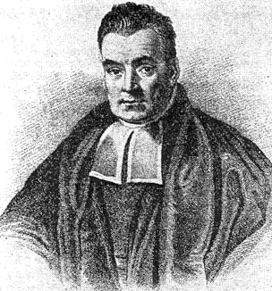
Characteristics
Data-driven, not model-driven
Makes no assumptions about the data
Named after mid-16th century English statistician and Presbyterian minister Thomas Bayes

Slide 3
Naïve Bayes: The Basic Idea
For a given new record to be classified, find other records like it (i.e., same values for the predictors)
What is the prevalent class among those records?
Assign that class to your new record

Slide 4
Usage
Requires categorical variables
Numerical variable must be binned and converted to categorical
Can be used with very large data sets
Example: Spell check programs assign your misspelled word to an established “class” (i.e., correctly spelled word)

Slide 5
Exact Bayes Classifier
Relies on finding other records that share same predictor values as record-to-be-classified.
Want to find “probability of belonging to class C, given specified values of predictors.”
Even with large data sets, may be hard to find other records that exactly match your record, in terms of predictor values.

Slide 6
Solution – Naïve Bayes
Assume independence of predictor variables (within each class)
Use multiplication rule
Find same probability that record belongs to class C, given predictor values, without limiting calculation to records that share all those same values

Slide 7
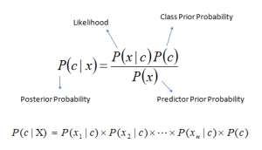
Bayes theorem provides a way of calculating posterior probability P(c|x) from P(c), P(x) and P(x|c). Look at the equation below:
Above,
P(c|x) is the posterior probability of class (c, target) given predictor (x, attributes).
P(c) is the prior probability of class.
P(x|c) is the likelihood which is the probability of predictor given class.
P(x) is the prior probability of predictor.

Slide 8
Problem:
Players will play if weather is sunny. Is this statement is correct?
We can solve it using above discussed method of posterior probability.
P(Yes | Sunny) = P( Sunny | Yes) * P(Yes) / P (Sunny)
Here we have P (Sunny |Yes) = 3/9 = 0.33, P(Sunny) = 5/14 = 0.36, P( Yes)= 9/14 = 0.64
Now, P (Yes | Sunny) = 0.33 * 0.64 / 0.36 = 0.60, which has higher probability.
Naive Bayes uses a similar method to predict the probability of different class based on various attributes. This algorithm is mostly used in text classification and with problems having multiple classes.

Slide 9
How does it work
Step 1: Convert the data set into a frequency table
Step 2: Create Likelihood table by finding the probabilities like Overcast probability = 0.29 and probability of playing is 0.64
Step 3: Now, use Naive Bayesian equation to calculate the posterior probability for each class. The class with the highest posterior probability is the outcome of prediction.

Slide 10
Naive Bayes classifiers are a collection of classification algorithms based on Bayes’ Theorem. It is not a single algorithm but a family of algorithms where all of them share a common principle, i.e. every pair of features being classified is independent of each other.
Consider a fictional dataset that describes the weather conditions for playing a game of golf. Given the weather conditions, each tuple classifies the conditions as fit(“Yes”) or unfit(“No”) for plaing golf.
Here is a tabular representation of our dataset.
The dataset is divided into two parts, namely, feature matrix and the response vector.
Feature matrix contains all the vectors(rows) of dataset in which each vector consists of the value of dependent features. In above dataset, features are ‘Outlook’, ‘Temperature’, ‘Humidity’ and ‘Windy’.
Response vector contains the value of class variable(prediction or output) for each row of feature matrix. In above dataset, the class variable name is ‘Play golf’.

Slide 11
 | OUTLOOK | TEMPERATURE | HUMIDITY | WINDY | PLAY GOLF
0 | Rainy | Hot | High | False | No
1 | Rainy | Hot | High | True | No
2 | Overcast | Hot | High | False | Yes
3 | Sunny | Mild | High | False | Yes
4 | Sunny | Cool | Normal | False | Yes
5 | Sunny | Cool | Normal | True | No
6 | Overcast | Cool | Normal | True | Yes
7 | Rainy | Mild | High | False | No
8 | Rainy | Cool | Normal | False | Yes
9 | Sunny | Mild | Normal | False | Yes
10 | Rainy | Mild | Normal | True | Yes
11 | Overcast | Mild | High | True | Yes
12 | Overcast | Hot | Normal | False | Yes
13 | Sunny | Mild | High | True | No

Slide 12
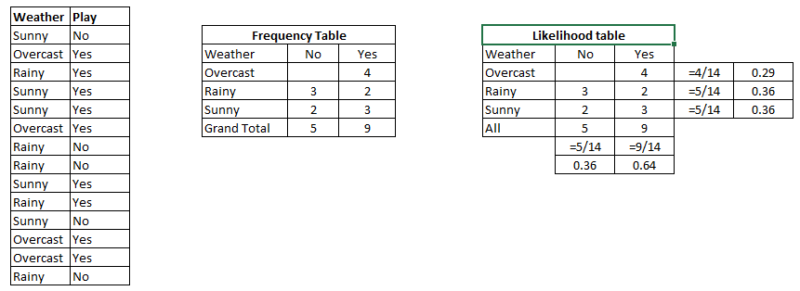
Data

Slide 13


Bayes’ Theorem
Bayes’ Theorem finds the probability of an event occurring given the probability of another event that has already occurred. Bayes’ theorem is stated mathematically as the following equation:
where A and B are events and P(B) ? 0.
Basically, we are trying to find probability of event A, given the event B is true. Event B is also termed as evidence.
P(A) is the priori of A (the prior probability, i.e. Probability of event before evidence is seen). The evidence is an attribute value of an unknown instance(here, it is event B).
P(A|B) is a posteriori probability of B, i.e. probability of event after evidence is seen.
Now, with regards to our dataset, we can apply Bayes’ theorem in following way:
where, y is class variable and X is a dependent feature vector (of size n) where:

Slide 14

Naive assumption
Now, its time to put a naive assumption to the Bayes’ theorem, which is, independence among the features. So now, we split evidence into the independent parts.
Now, if any two events A and B are independent, then,
P(A,B) = P(A)P(B)
Hence, we reach to the result:
which can be expressed as:
Now, as the denominator remains constant for a given input, we can remove that term:
Now, we need to create a classifier model. For this, we find the probability of given set of inputs for all possible values of the class variable y and pick up the output with maximum probability. This can be expressed mathematically as:

Slide 15
Now, we need to create a classifier model. For this, we find the probability of given set of inputs for all possible values of the class variable y and pick up the output with maximum probability. This can be expressed mathematically as:
So, finally, we are left with the task of calculating P(y) and P(xi | y).
Please note that P(y) is also called class probability and P(xi | y) is called conditional probability.
The different naive Bayes classifiers differ mainly by the assumptions they make regarding the distribution of P(xi | y).

Slide 16
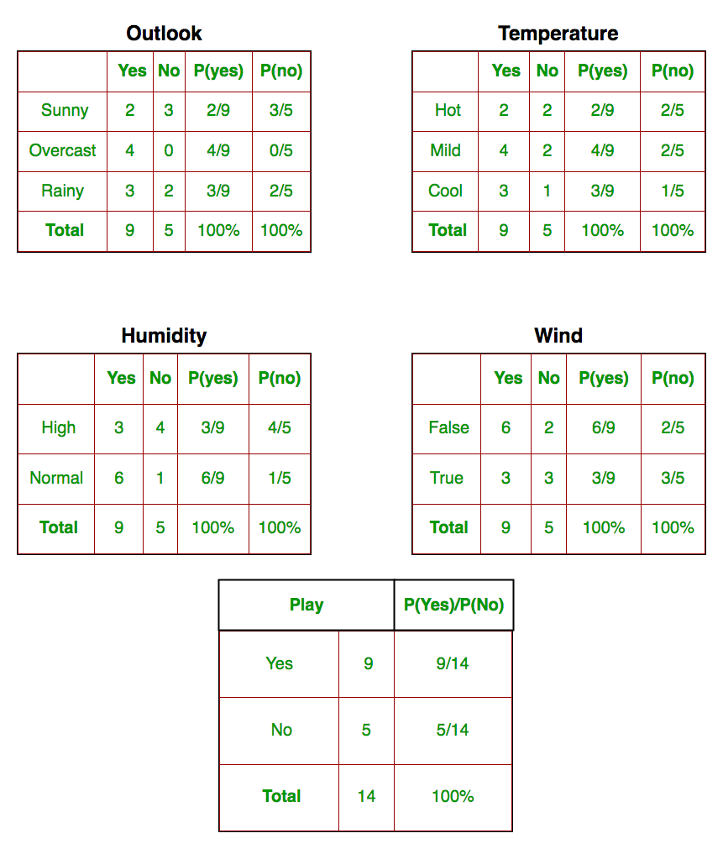
Let us try to apply the above formula manually on our weather dataset. For this, we need to do some precomputations on our dataset.
We need to find P(x_{i} | y_{j}) for each x_{i} in X and y_{j} in y. All these calculations have been demonstrated in the tables below:

Slide 17
Calculations
Take a record, and note its predictor values
Find the probabilities those predictor values occur across all records in C1
Multiply them together, then by proportion of records belonging to C1
Same for C2, C3, etc.
Prob. of belonging to C1 is value from step (3) divide by sum of all such values C1 … Cn
Establish & adjust a “cutoff” prob. for class of interest

Slide 18
So, in the figure above, we have calculated P(x_{i} | y_{j}) for each x_{i} in X and y_{j} in y manually in the tables 1-4. For example, probability of playing golf given that the temperature is cool, i.e P(temp. = cool | play golf = Yes) = 3/9.
Also, we need to find class probabilities (P(y)) which has been calculated in the table 5. For example, P(play golf = Yes) = 9/14.
So now, we are done with our pre-computations and the classifier is ready!
Let us test it on a new set of features (let us call it today):
today = (Sunny, Hot, Normal, False)

Slide 19
So, probability of playing golf is given by:
and probability to not play golf is given by:
Since, P(today) is common in both probabilities, we can ignore P(today) and find proportional probabilities as:
and

Slide 20
Now, since
P(Yes | today) + P(No | today) = 1
These numbers can be converted into a probability by making the sum equal to 1 (normalization):
and
Since
P(Yes | today) > P(No | today)
So, prediction that golf would be played is ‘Yes’.

Slide 21
The method that we discussed above is applicable for discrete data. In case of continuous data, we need to make some assumptions regarding the distribution of values of each feature. The different naive Bayes classifiers differ mainly by the assumptions they make regarding the distribution of P(x_{i} | y).

Slide 22
Example: Financial Fraud
Target variable: Audit finds fraud, no fraud
Predictors:
Prior pending legal charges (yes/no)
Size of firm (small/large)

Slide 24
Exact Bayes Calculations
Goal: classify (as “fraudulent” or as “truthful”) a small firm with charges filed
There are 2 firms like that, one fraudulent and the other truthful
P(fraud | charges=y, size=small) = ½ = 0.50
Note: calculation is limited to the two firms matching those characteristics

Slide 25
Naïve Bayes Calculations
Same goal as before
Compute 2 quantities:
Proportion of “charges = y” among frauds, times proportion of “small” among frauds, times proportion frauds = 3/4 * 1/4 * 4/10 = 0.075
Prop “charges = y” among frauds, times prop. “small” among truthfuls, times prop. truthfuls = 1/6 * 4/6 * 6/10 = 0.067
P(fraud | charges, small) = 0.075/(0.075+0.067)
= 0.53

Slide 26
Naïve Bayes, cont.
Note that probability estimate does not differ greatly from exact
All records are used in calculations, not just those matching predictor values
This makes calculations practical in most circumstances
Relies on assumption of independence between predictor variables within each class

Slide 27
Independence Assumption
Not strictly justified (variables often correlated with one another)
Often “good enough” – ranking of probabilities is more important than unbiased estimate of actual probabilities

Slide 28
Naïve Bayes in R
Use package e1071
Function naiveBayes
See Table 8.4 for code for running Naïve Bayes
Includes code for binning numeric variables into categories, which is required for NB

Slide 29
Advantages
Handles purely categorical data well
Works well with very large data sets
Simple & computationally efficient

Slide 30
Shortcomings
Requires large number of records
Problematic when a predictor category is not present in training data
Assigns 0 probability of response, ignoring information in other variables

Slide 31
On the other hand…
Probability rankings are more accurate than the actual probability estimates
Good for applications using lift (e.g. response to mailing), less so for applications requiring probabilities (e.g. credit scoring)

Slide 32
Summary
No statistical models involved
Naïve Bayes (like KNN) pays attention to complex interactions and local structure
Computational challenges remain

